Slide 1
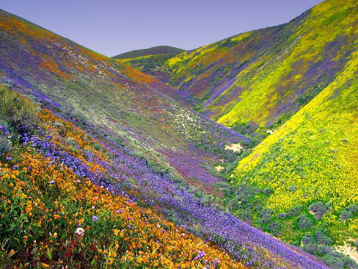
Measuring Species Richness

Slide 2
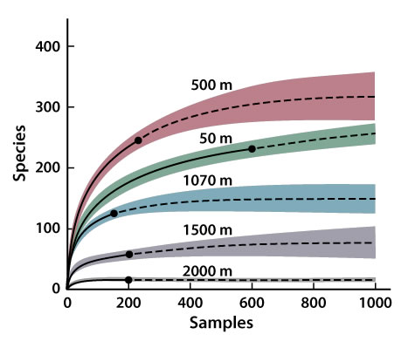
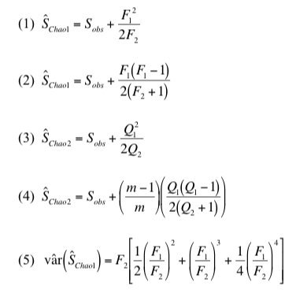
Species Richness Estimators: what is the ‘True’ species richness?
Work from Anne Chao and others

Slide 3
Assumption that there is an asymptote in species richness is invalid
Sampling extent
Number of species
Many solutions, all make improbable assumptions at some scale
Area, samples, or individuals

Slide 4
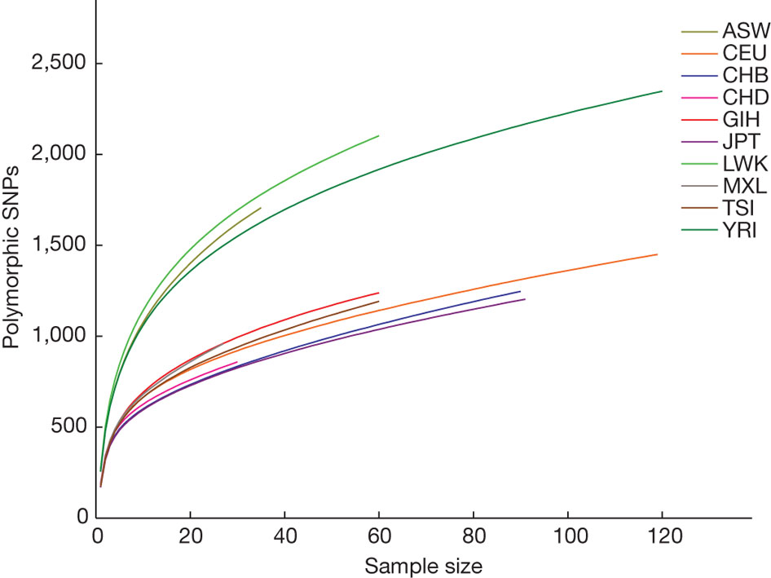
Same problems in genomics/genetics….

Slide 5
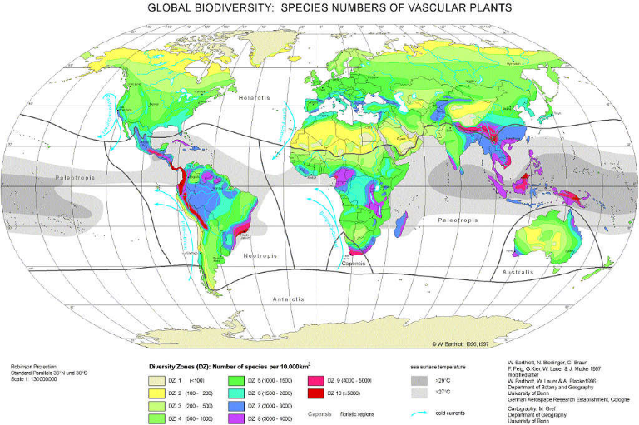
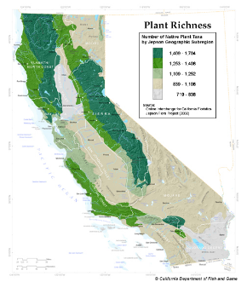
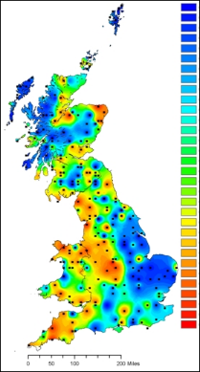
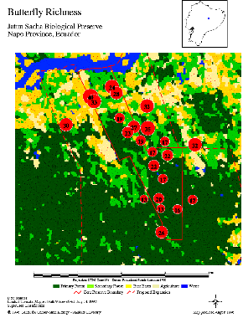
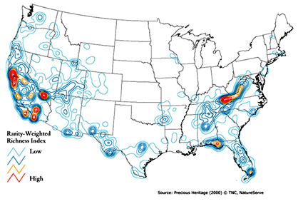
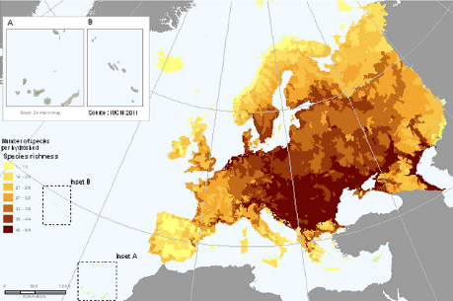
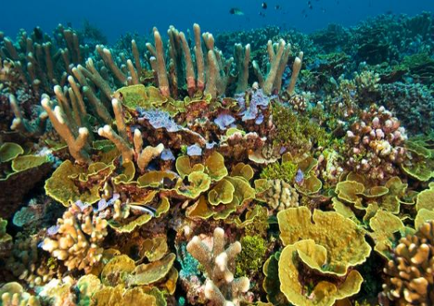
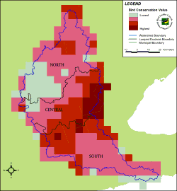

Slide 6
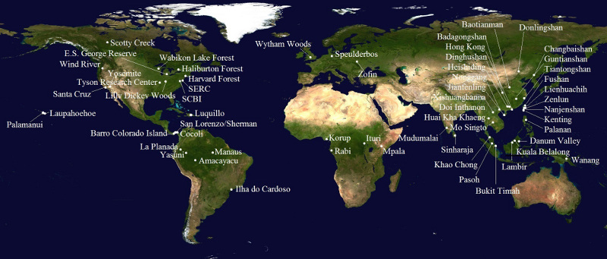
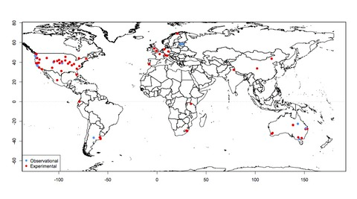
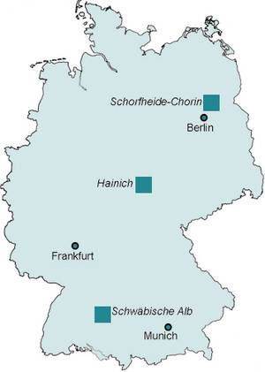
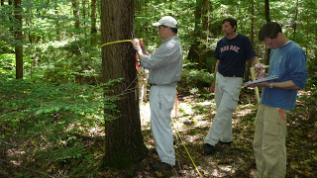
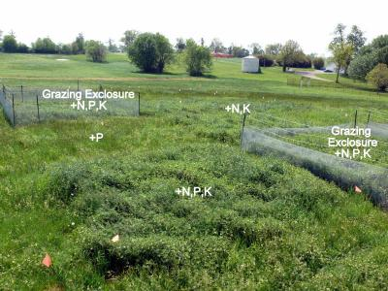

Aren’t consistent sampling schemes enough?
Unfortunately, no….
CTFS-SGIEO Forest Plots
NutNet Forest Plots

Slide 7
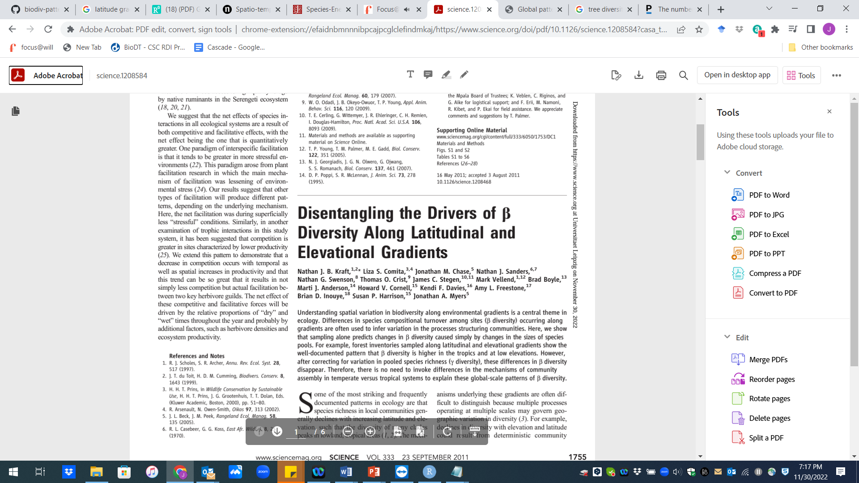
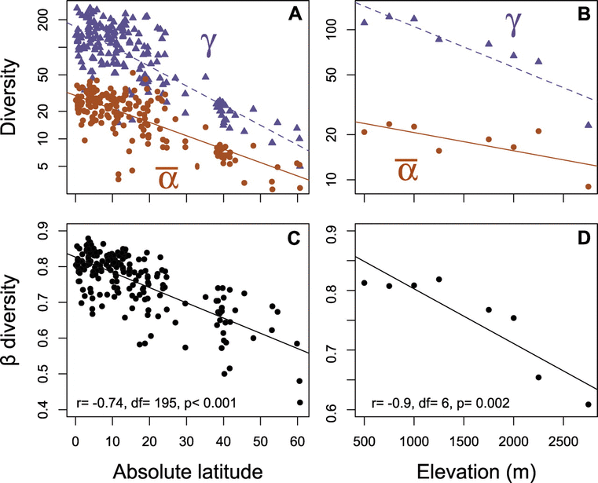
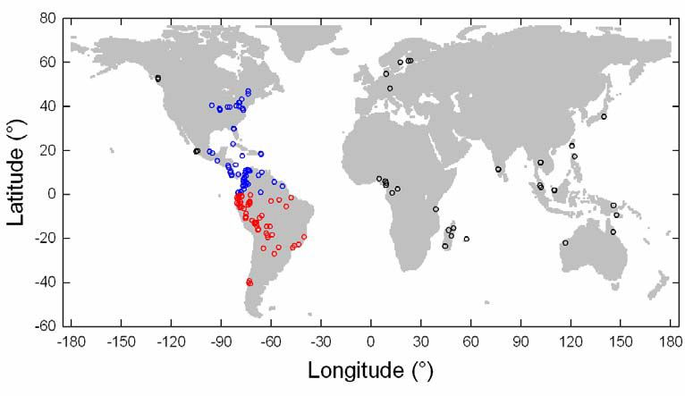

Slide 8
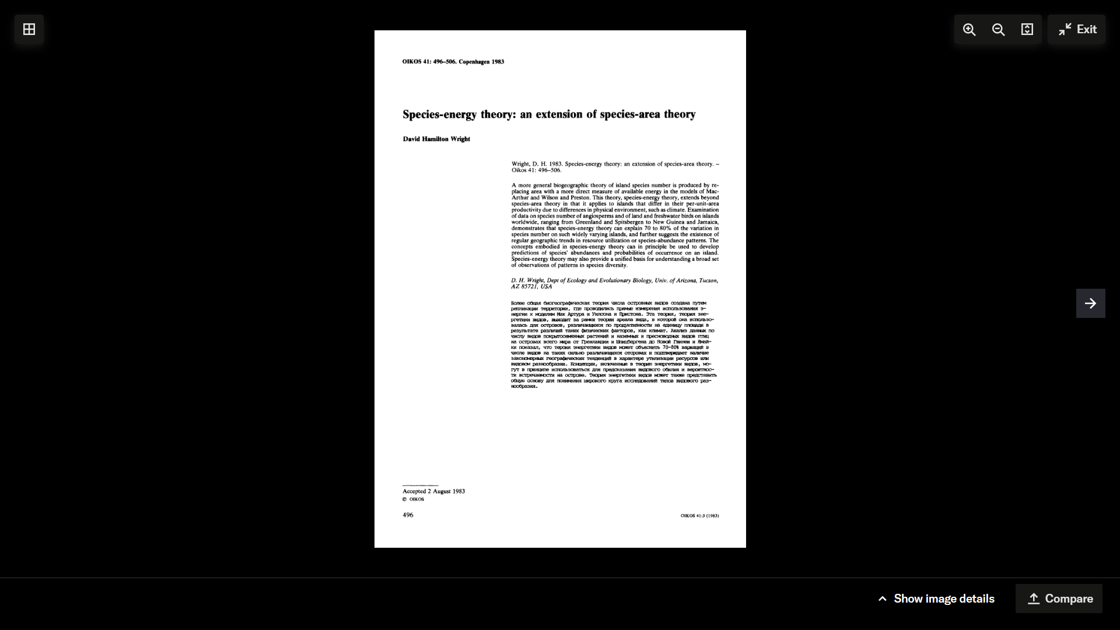
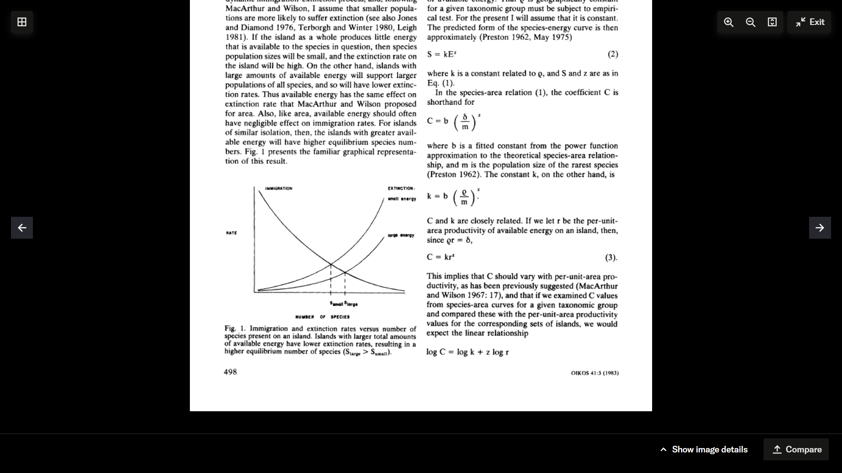
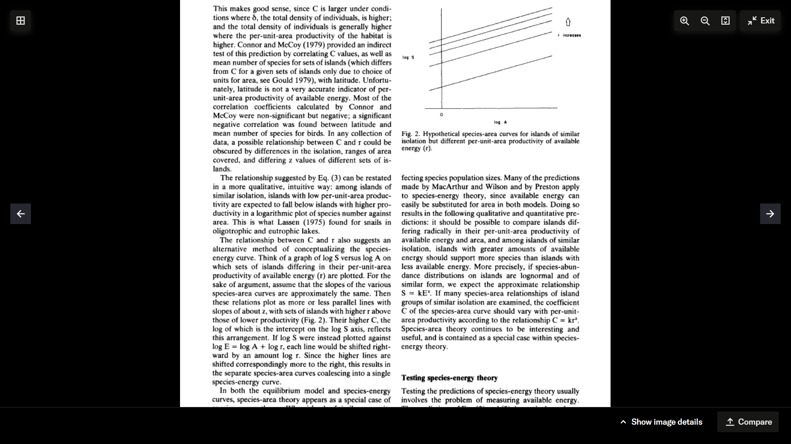

Slide 9
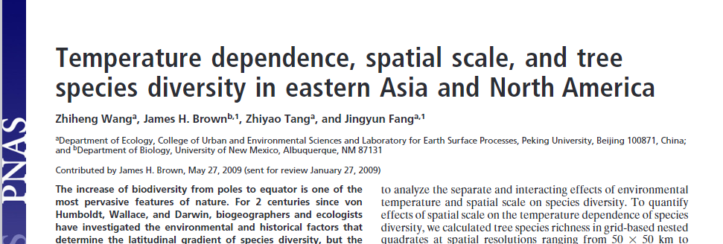

Slide 10
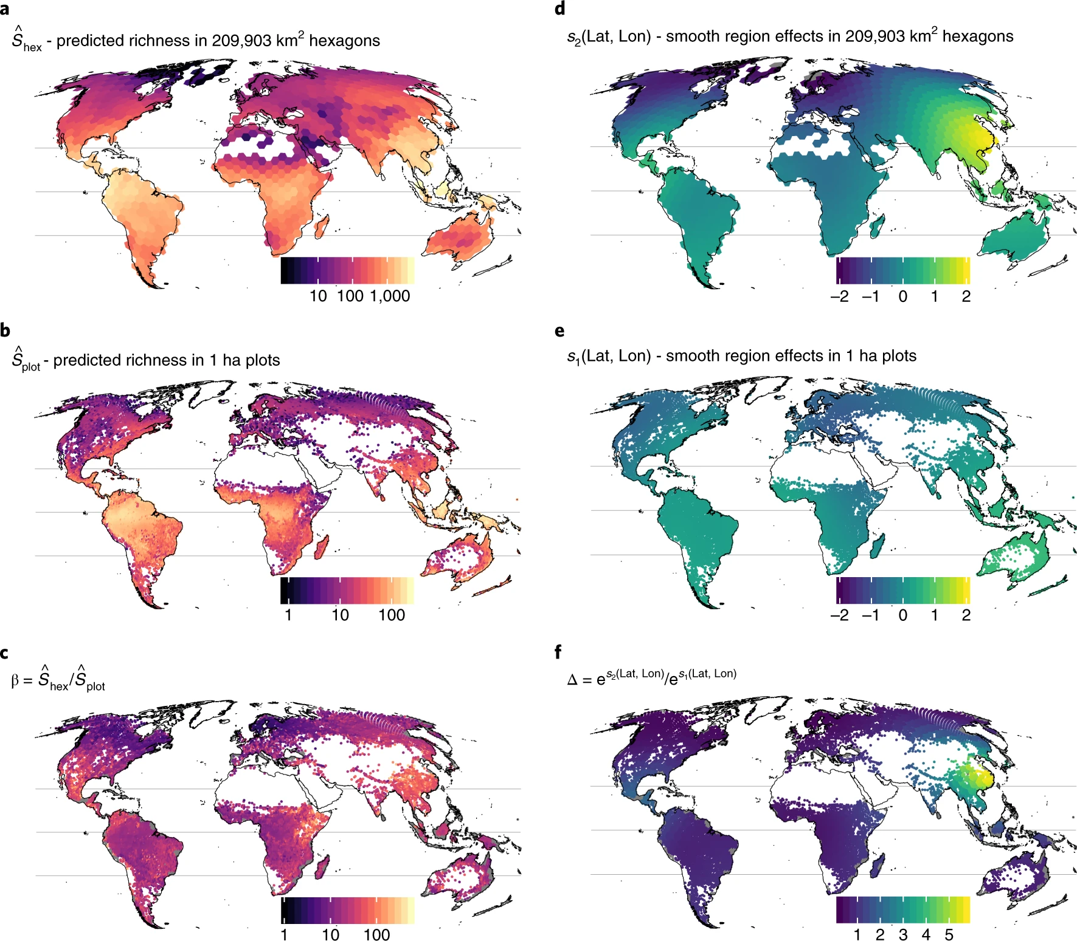
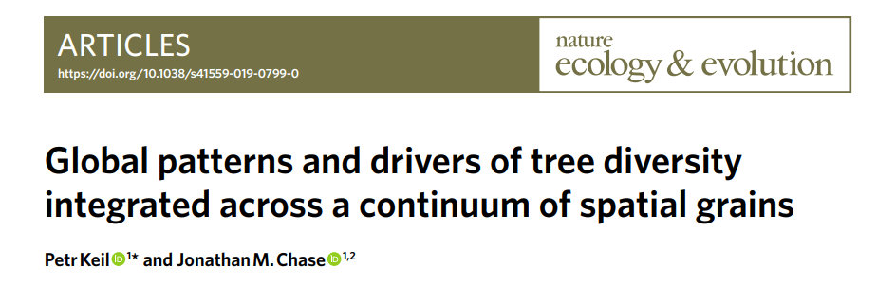
Keil and Chase 2019

Slide 11
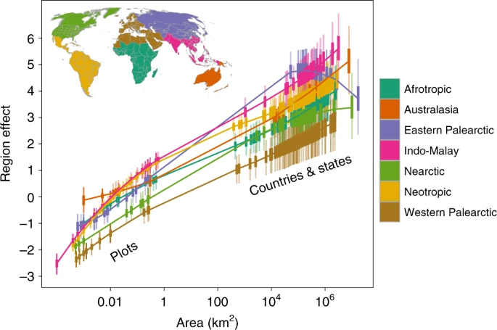
Keil and Chase 2019

Slide 12
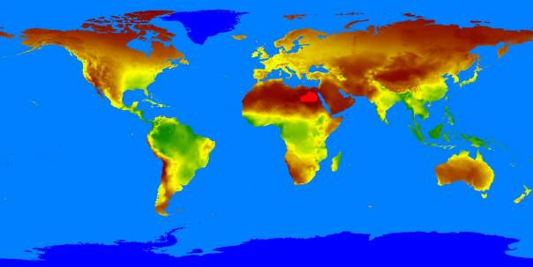
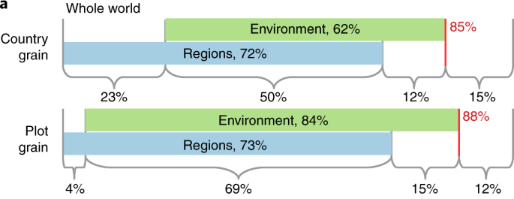
Environment and Region are not independent

Slide 13
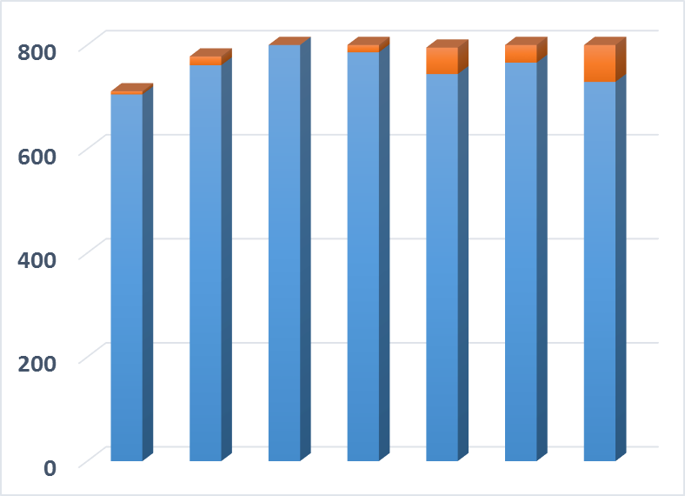
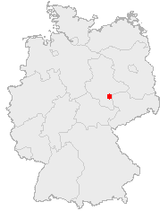
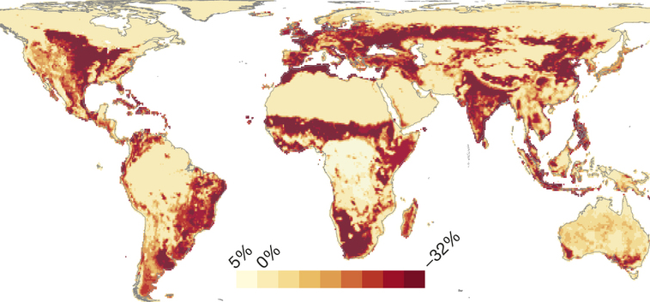
Scale-Dependent Biodiversity Change
Number of Species
Public Domain, https://commons.wikimedia.org/w/index.php?curid=362363
~1700
1850
1950
~Today
Year
Data from: Knapp, S., et al. 2016. Increasing species richness but decreasing phylogenetic richness and divergence over a 320‐year period of urbanization. Journal of Applied Ecology. doi:10.1111/1365-2664.12826
Reprinted by permission from Macmillan Publishers Ltd: Newbold, T., et al. 2015. Global effects of land use on local terrestrial biodiversity. Nature, 520: 45-50.

Slide 14
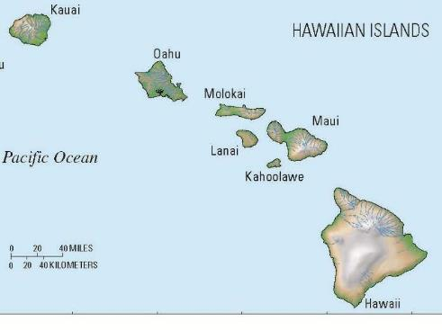
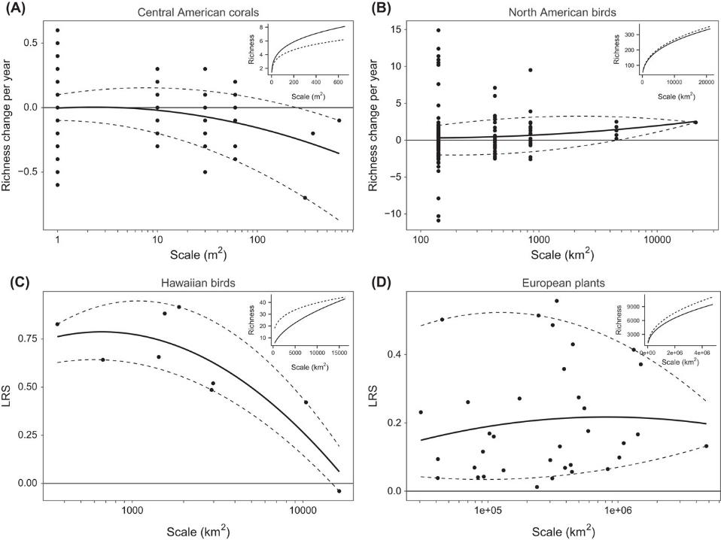
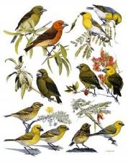
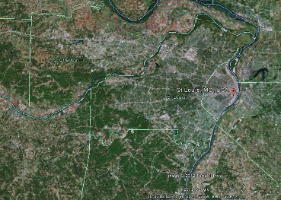
Homogenization or Differentiation

Slide 15
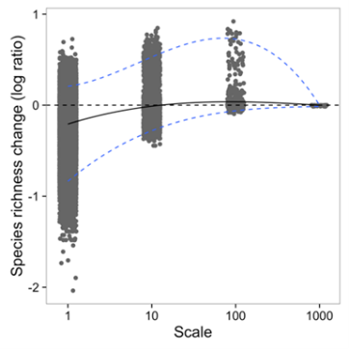
Biodiversity change—Scale matters
Theoretical Expectations
Meta-analytical results (plants only)

Slide 16
Questions? (5-10 Minutes)
Breakout—Discussion amongst yourselves (10 minutes)
-Are there any general laws in biodiversity patterns?
Discussion as a group (10 minutes)
10 min break

